Slide 1
Game User & Revenue Analysis Data-driven insights into user behavior, engagement, and monetization from game platform data (2023–2025) Prepared by: Ritesh Patel Tool Used: Power BI Dataset Size: 10,000 users

Slide 2
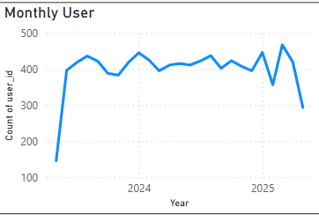
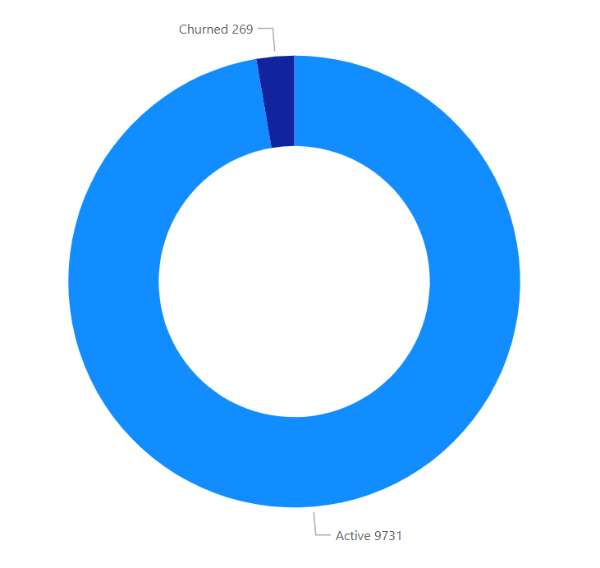
Total Users: 10,000
Signups Steady: Monthly new user count is consistent from early 2023 through 2025
Churn Rate: ~2.7% (269 users with <5 days active)
Average Days Active: ~349
User Overview & Growth
Churned - 269
Active - 9731

Slide 3
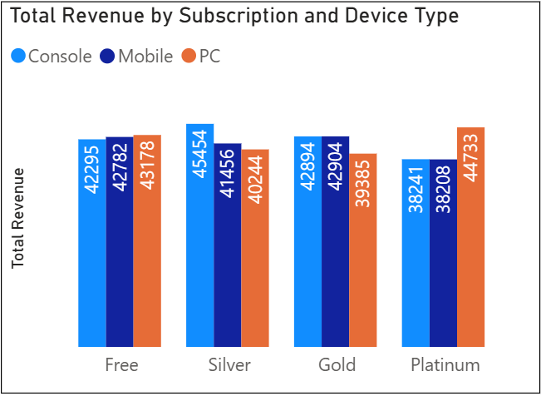
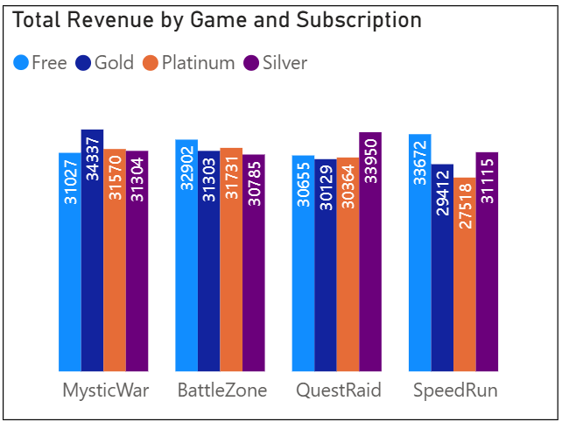
Revenue & Monetization
Total Revenue: $501,775
Average Revenue per User (ARPU): $50
Top Earning Game: QuestRaid
Highest Revenue Tier: Platinum
Top Performing Devices: PC users spend slightly more than Mobile or Console

Slide 4
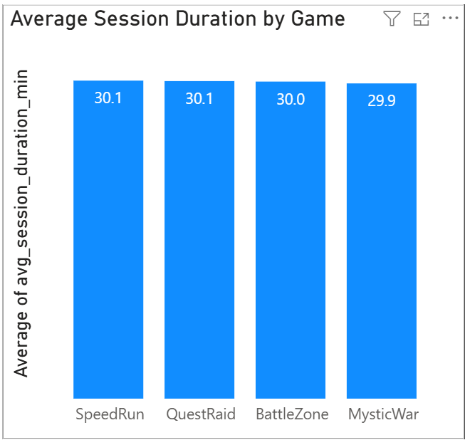
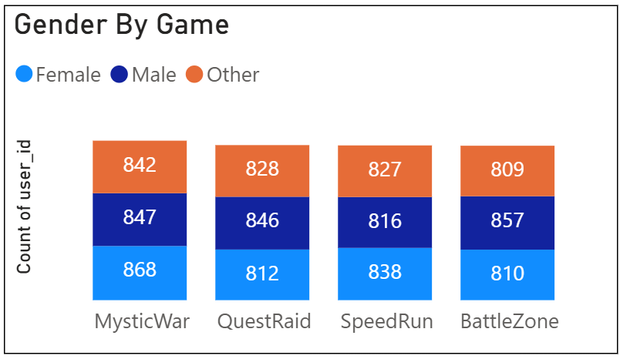
Engagement & Game Behavior
Users prefer SpeedRun and QuestRaid in terms of longer session duration (avg. ~30 min)
Male and Female user counts are nearly balanced across games
Ranking distribution shows Free and Gold tier users dominating higher ranks

Slide 5
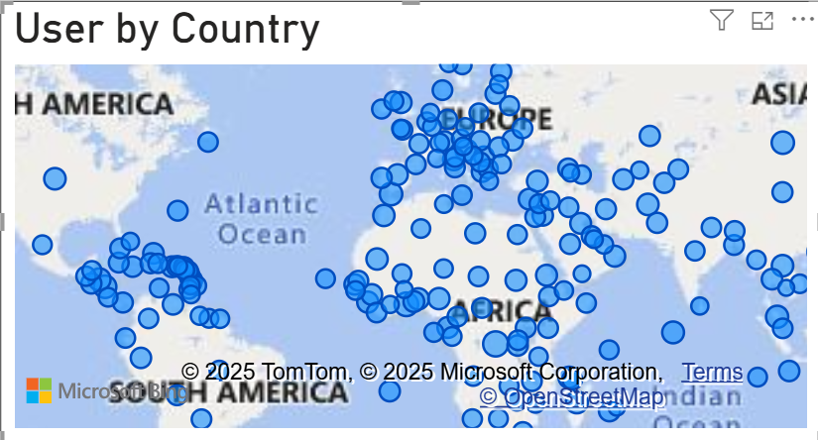
User Segments & Global Spread
User base is globally distributed — strong presence in North America, Europe, and Asia
Churn is not region-specific — retention strategies can be standardized
High engagement observed across devices and regions

Slide 6
Thank You

